Slide 1
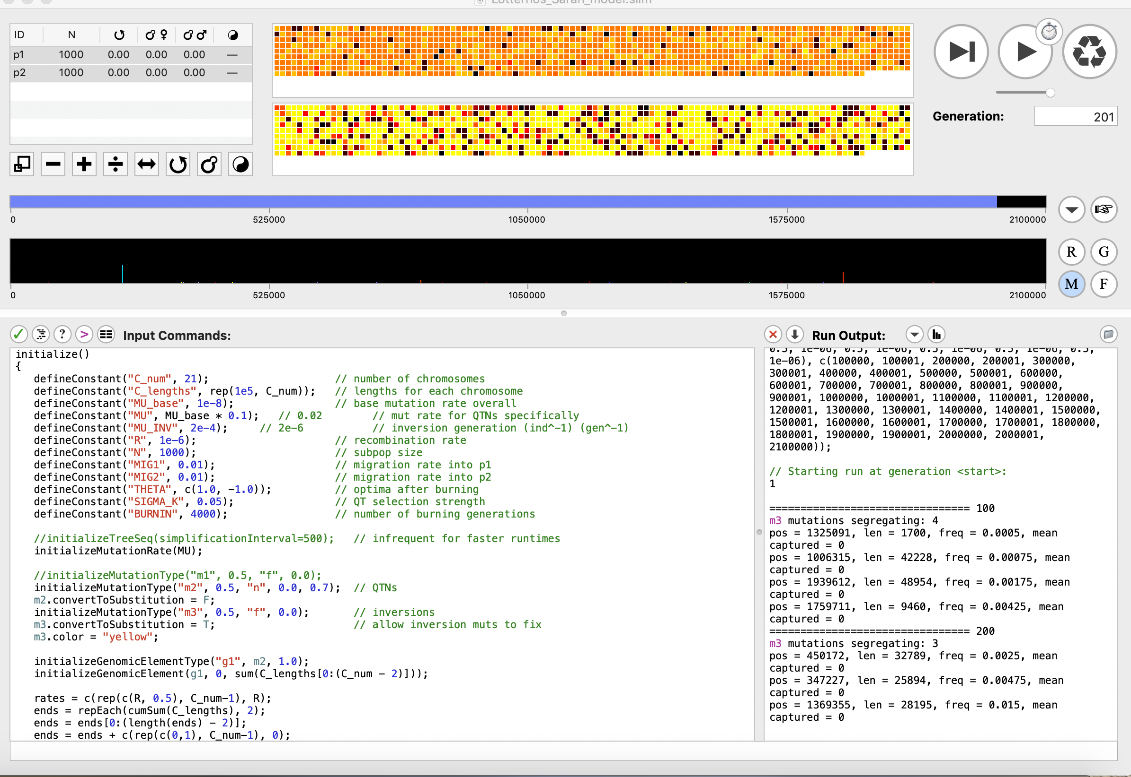
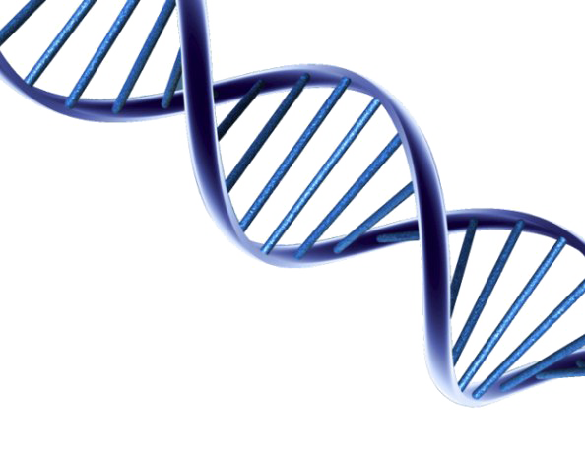
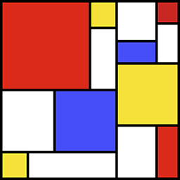
Inversion Invasions: Spread and maintenance of inversion polymorphisms in a two-patch model undergoing divergent selection
Sara M. Schaal, Ben Haller & Katie E. Lotterhos
SLiM

Slide 2
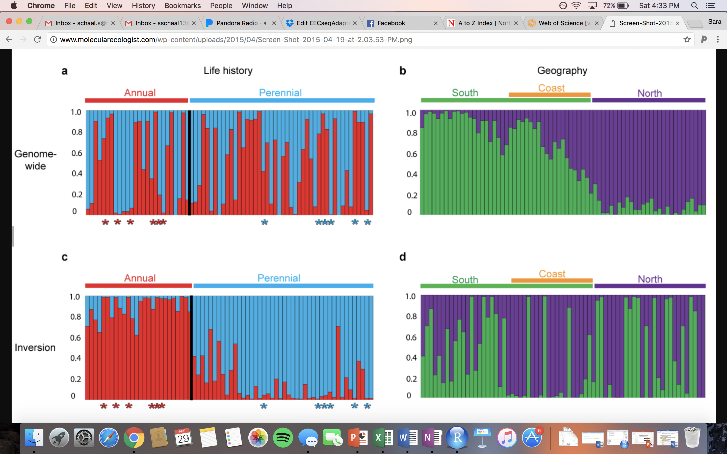
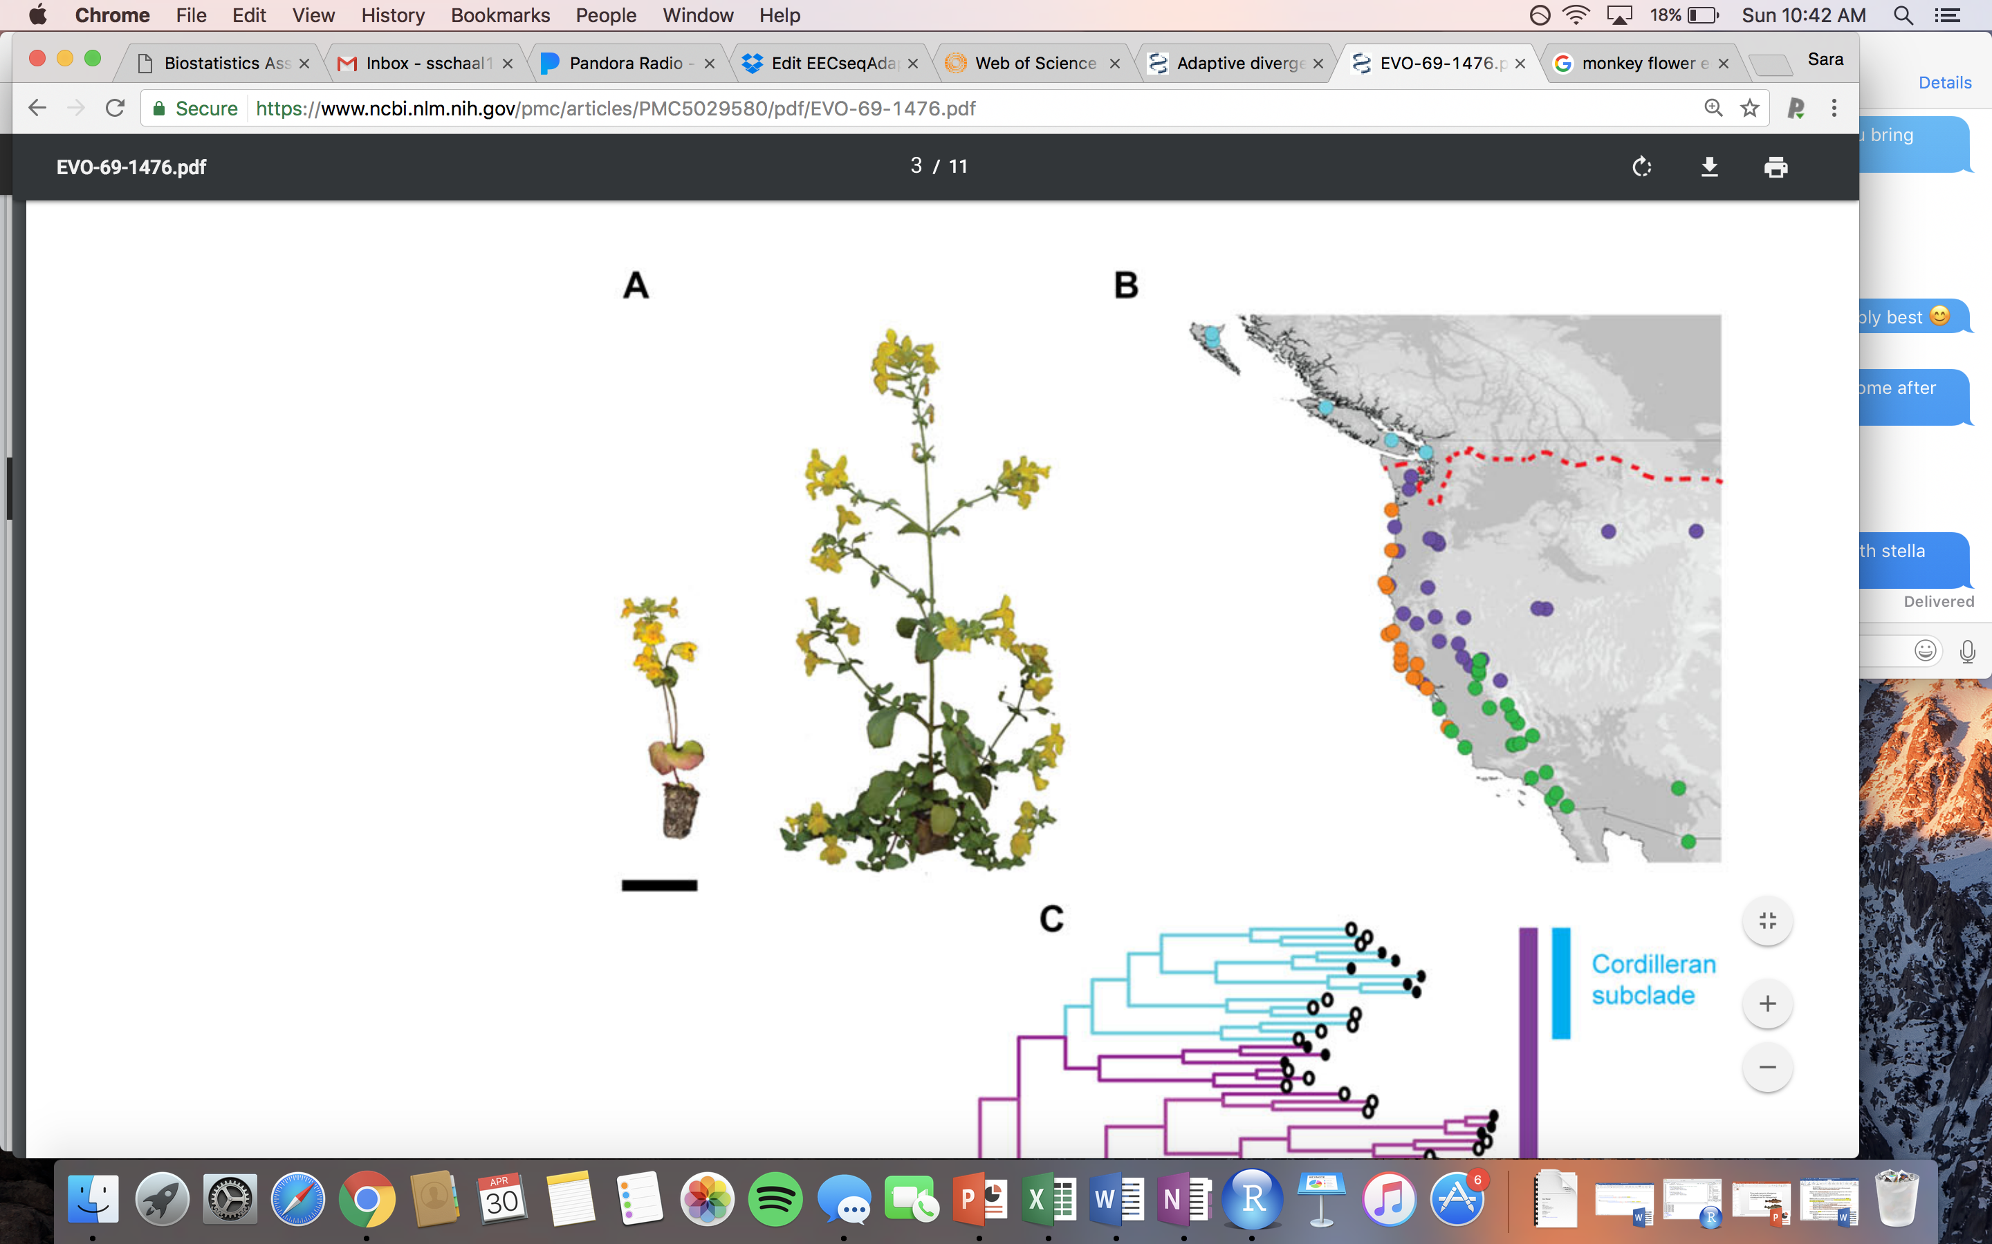
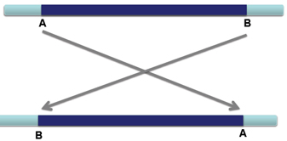
Genomics of Ecotypes
Non-Neutral Divergence
Regions of Low Recombination
Annual and Perennial Monkeyflower
Inversions
Twyford & Friedman 2015
Notes:
At the genome level ecotypes vary at regions linked to the traits that are causing their divergence.
Strong selection on the traits of interest
Annual and perennial that vary in flowering time and growth

Slide 3
Previous Inversion Theory
Period of Allopatry or No Gene Flow
Original Population
Gene Flow Occurring
Notes:
Requires a period of low gene flow
Didn’t really look at high gene flow conditions
Instead: a lot of theory in this field… but what is missing/ none of them have done this
K&B implicit – period of allopatry: then feder to create this they had a period of no gene flow followed by secondary contact
Schematic like size alleles in the inversions

Slide 4
Previous Inversion Theory
Period of Allopatry or No Gene Flow
Original Population
Separation Occurs
Notes:
Requires a period of low gene flow
Didn’t really look at high gene flow conditions
Instead: a lot of theory in this field… but what is missing/ none of them have done this
K&B implicit – period of allopatry: then feder to create this they had a period of no gene flow followed by secondary contact
Schematic like size alleles in the inversions

Slide 5
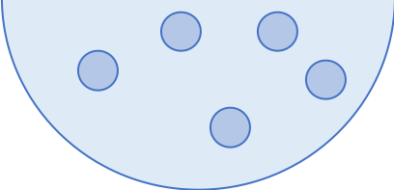
Previous Inversion Theory
Period of Allopatry or No Gene Flow
Original Population
Adaptation in Isolation
Notes:
Requires a period of low gene flow
Didn’t really look at high gene flow conditions
Instead: a lot of theory in this field… but what is missing/ none of them have done this
K&B implicit – period of allopatry: then feder to create this they had a period of no gene flow followed by secondary contact
Schematic like size alleles in the inversions

Slide 6
Previous Inversion Theory
Period of Allopatry or No Gene Flow
Original Population
Secondary Contact
Notes:
Requires a period of low gene flow
Didn’t really look at high gene flow conditions
Instead: a lot of theory in this field… but what is missing/ none of them have done this
K&B implicit – period of allopatry: then feder to create this they had a period of no gene flow followed by secondary contact
Schematic like size alleles in the inversions

Slide 7
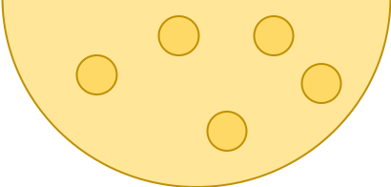
Previous Inversion Theory
Period of Allopatry or No Gene Flow
Original Population
Adaptation with some gene flow
Low Gene Flow Scenarios
Notes:
Requires a period of low gene flow
Didn’t really look at high gene flow conditions
Instead: a lot of theory in this field… but what is missing/ none of them have done this
K&B implicit – period of allopatry: then feder to create this they had a period of no gene flow followed by secondary contact
Schematic like size alleles in the inversions

Slide 8
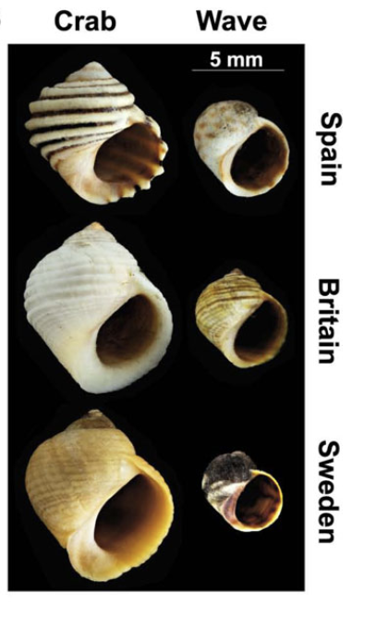
Previous Inversion Theory
Period of Allopatry or No Gene Flow
Ecotypes with High Gene Flow?
Notes:
Requires a period of low gene flow
Didn’t really look at high gene flow conditions
Instead: a lot of theory in this field… but what is missing/ none of them have done this
K&B implicit – period of allopatry: then feder to create this they had a period of no gene flow followed by secondary contact
Schematic like size alleles in the inversions

Slide 9
Previous Inversion Theory
Period of Allopatry or No Gene Flow
Ecotypes with High Gene Flow?
Do inversions aid in local adaptation under sympatric divergence scenarios?
Notes:
Requires a period of low gene flow
Didn’t really look at high gene flow conditions
Instead: a lot of theory in this field… but what is missing/ none of them have done this
K&B implicit – period of allopatry: then feder to create this they had a period of no gene flow followed by secondary contact
Schematic like size alleles in the inversions

Slide 10
Previous Inversion Theory
Period of Allopatry or No Gene Flow
Fixed Inversion Characteristics
Fixed Length
Original Population
Inversion
Adaptation with some gene flow
Fixed Age
Notes:
Requires a period of low gene flow
Didn’t really look at high gene flow conditions
Instead: a lot of theory in this field… but what is missing/ none of them have done this
K&B implicit – period of allopatry: then feder to create this they had a period of no gene flow followed by secondary contact
Schematic like size alleles in the inversions

Slide 11
Previous Inversion Theory
Period of Allopatry or No Gene Flow
Fixed Inversion Characteristics
QTN
Original Population
Adaptation with some gene flow
captures QTNs at the time of mutation
Notes:
Requires a period of low gene flow
Didn’t really look at high gene flow conditions
Instead: a lot of theory in this field… but what is missing/ none of them have done this
K&B implicit – period of allopatry: then feder to create this they had a period of no gene flow followed by secondary contact
Schematic like size alleles in the inversions

Slide 12
Previous Inversion Theory
Period of Allopatry or No Gene Flow
Fixed Inversion Characteristics
QTN
Original Population
Initially neutral inversion
Adaptation with some gene flow
QTNs arise through mutations in inversion
Notes:
Requires a period of low gene flow
Didn’t really look at high gene flow conditions
Instead: a lot of theory in this field… but what is missing/ none of them have done this
K&B implicit – period of allopatry: then feder to create this they had a period of no gene flow followed by secondary contact
Schematic like size alleles in the inversions

Slide 13
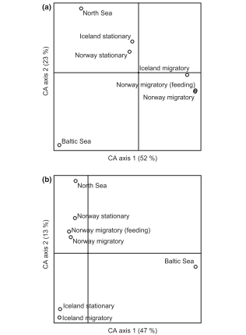
Stationary
Migratory

Slide 14
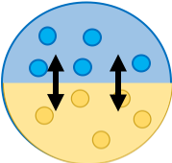
Research Questions
Do inversions facilitate local adaptation under gene flow?
QTN Mutation Rate
Selection Strength
QTN Effect Size
Migration Rate
Notes:
Show the two patch model here

Slide 15

Research Questions
For an adaptive inversion to segregate under local adaptation with gene flow, does it require specific characteristics?
Do inversions facilitate local adaptation under gene flow?
QTN Mutation Rate
capture
Selection Strength
QTN Effect Size
Migration Rate
Notes:
Show the two patch model here

Slide 16

Research Questions
For an adaptive inversion to segregate under local adaptation with gene flow, does it require specific characteristics?
Do inversions facilitate local adaptation under gene flow?
QTN Mutation Rate
capture
Selection Strength
QTN Effect Size
mutation
Migration Rate
Notes:
Show the two patch model here

Slide 17

Research Questions
For an adaptive inversion to segregate under local adaptation with gene flow, does it require specific characteristics?
Do inversions facilitate local adaptation under gene flow?
QTN Mutation Rate
capture
Selection Strength
QTN Effect Size
mutation
Migration Rate
combination
Notes:
Show the two patch model here

Slide 18
Model Overview
𝜽₁
𝜽₂
Fitness
-1
+1
-1
+1
Phenotype

Slide 19
Model Overview
Migration
𝜽₁
𝜽₂
Fitness
-1
+1
-1
+1
Phenotype

Slide 20
Model Overview
Migration
𝜽₁
𝜽₂
Fitness
-1
+1
-1
+1
Phenotype

Slide 21
Model Overview
Migration
Reproduction
θ
Fitness
Fitness
z
Phenotype

Slide 22
Model Overview
Migration
Reproduction
Generate Offspring
θ
Fitness
Fitness
z
Phenotype

Slide 23
Model Overview
Migration
Reproduction
Generate Offspring
Mutation
θ
Fitness
Fitness
z
Phenotype

Slide 24
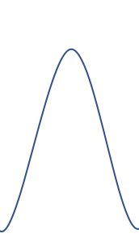
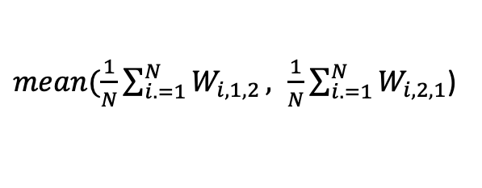
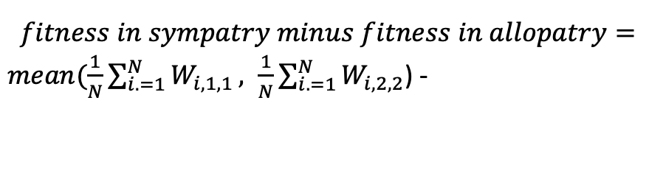
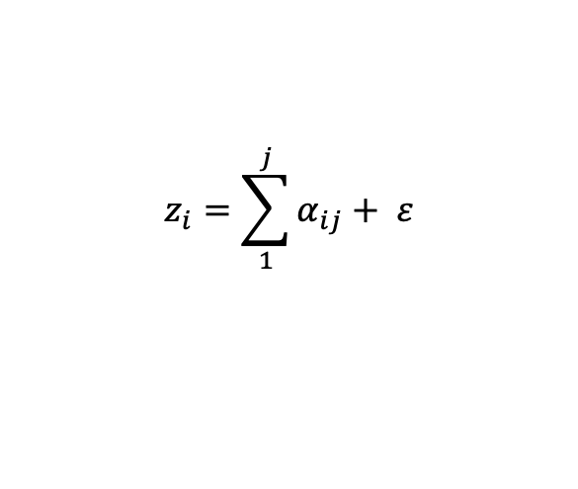
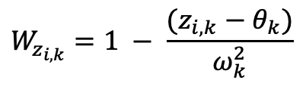
Model Overview
Stabilizing Selection
Population Level
Phenotype
Fitness
θ
Gen 1
Gen 2
$$z_{i}=\sum_{1}^{j}{α_{ij}}+ ε$$
Fitness
$$W_{z_{i,k}}=1 − \frac{(z_{i,k}−θ_{k})}{ω_{k}^{2}}$$
Frequency
Local Adaptation
Trait Value
$$fitness in sympatry minus fitness in allopatry=$$
$mean(\frac{1}{N}\sum_{i. =1}^{N}{W_{i,1,1}}, \frac{1}{N}\sum_{i. =1}^{N}{W_{i,2,2}}$) -
Individual Level
$mean(\frac{1}{N}\sum_{i. =1}^{N}{W_{i,1,2}}, \frac{1}{N}\sum_{i. =1}^{N}{W_{i,2,1}}$)
θ
Fitness
Fitness
z
Trait Value

Slide 25
Local Adaptation
Do inversions facilitate local adaptation under gene flow?

Slide 26
Local Adaptation – Low QTN effect size
High selection (sigmaK = 0.75)
Moderate selection (sigmaK = 1.5)
Low selection (sigmaK = 3.0)
Notes:
Number and distribution of effect sizes

Slide 27
Local Adaptation
2. For an adaptive inversion to segregate under local adaptation with gene flow, does it require capturing QTNs initially?

Slide 28
Conditions That Inversions Arose
Notes:
Migration rate
Inversion size on the x axis and proportion on the y
Sub categories for captured- mutations that arise later – how many arise
Inversion size on the x axis Proportion of SNPs in a category on the y – arose before the inversion
Colored by the number of SNPs in the inversion
Average the proportions for the boxplot across the replicates – say what the filtering is 0.05
Are the inversions that influence local adaptation old or new or neutral?
Later look at controlling for average age
Potential Filter after burnin and neutral at the end of burnin

Slide 29
Average Length of Inversions

Slide 30
Average Age of Inversions

Slide 31

Thank you!

Slide 32
Output Files
Every 200 generations
Inversion output
Gen | start_position | end_position | lengthINV | freq | freq_p1 | freq_p2 | mean_SelCoef | sd_SelCoef | mean_Dom | sd_Dom
Inversion QTN output
Generation | Inv_Pos | QTN_Pos | QTN_SelCoef | QTN_Dom | QTN_Freq_P1 | QTN_Freq_P2 | QTN_Freq
Population Summary
Gen | uniqueInvMuts | localAdapt | meanFitP1 | sdFitP1 | meanPhenoP1 | sdPhenoP1 | meanFitP2 | sdFitP2 | meanPhenoP2 | sdPhenoP2
End of Sim
Mutation Summary
position | selCoef | originGen | type | freq_p1 | freq_p2 | freq | AdaptPhenoDiv
Simulation Summary
Seed | Mig | Ne | Mu | Mu_Inv | Recom | Alpha | SelStrength
VCF & Individual Phenotype File

Slide 33
Questions
No inversions are fixing with QTNs.
Increase Mutation Rate
Human genetics find 1.78 to 1.88 mutations per 10,000 gametes per generation
0.712 to 0.752 mutation rate
More generations currently at 20,000 (< 10 min per sim) can bump to 200,000 (~73 min per sim)
Inversions are generally old in the literature – millions of years old
Time Series
Do you think it is a problem that I am only writing out every 200 generations?
cons: lose resolution could have inversion arise or be lost and not recorded
pros: saves time
Suggestions for other ways to analyze the time series data

Slide 34
Model Overview
Model Parameters
N = subpopulation size
m_{1,2} = migration from 1 to 2
m_{2,1} = migration from 1 to 2
Θ₁ = trait optimum in population 1
Θ₂ = trait optimum in population 2
σ = strength of selection (SD of the Gaussian fitness curve)
C = number of chromosomes
C_len = length of chromosomes
r = recombination rate
mu_base = neutral mutation rate
mu = QTN mutation rate
mu_inv = Inversion mutation rate
Inv_length = length of inversion (variable 100 bp - length half the chromosome size)
Dominance = variable dominance values at a loci (on or off)
envVar = environmental variance on the phenotype
Population 1
Population 2
m_{2,1}
N = 1000
N = 1000
m_{1,2}
Fitness
-1
+1
Phenotype
Notes:
Show the two patches with individuals inside the patches with the fitnesses for each patch
Then zoom in on a single individual genome to show the inversions vs. QTNs in the genome
Make the point that this is the most realistic simulation to date ABC pick three biggest ways my simulations are more realistic

